Slide 1
November Retest Administration Training
The Office of Student Assessment Services
September 9, 2024

Slide 2
1. Welcome

Slide 3
Presenters
Jodie Zalk, Manager of Test Administration and Publications
Robert Pelychaty, Manager of Inclusive Assessment
Scott Kelley, Data and Reporting Specialist
Shannon Cullen, MCAS Test Administration Coordinator
Holly Woodruff, Pearson Program Manager

Slide 4
Logistics for This Session
Use the Q&A feature to ask a question.
We will answer some questions aloud at specified times during this training session, and we will email the Q&A afterwards.
Type your questions anytime, but we may not answer them in real time as some questions may be covered during the presentation.
Use the thumbs-up icon to “upvote” someone else’s question.
Email student-specific questions to mcas@mass.gov instead of asking here.
This session is being recorded and will be available in about a week in the MCAS Resource Center, along with the slides.
Slides were also emailed out beforehand, and are being posted in the chat.
Closed captioning has been enabled for participants who need it.
This session is being interpreted into ASL. Our interpreting team will be onscreen with the presenters.

Slide 5
Slides for This Session
Slides were emailed to participants before this session from MCASEvents@cognia.org.
Slides are now being posted in the chat.
If you cannot access the slides in the chat, ask in the Q&A.
After the session, we will send the slides again to participants, and they will be posted in the MCAS Resource Center along with the recording.

Slide 6
Today’s Agenda and Resources
Welcome
Overview of Computer-Based Testing
PAN Overview Video
Pre-Administration Guide for the 2024 November Retests
Accessibility Features and Accommodations
Accessibility and Accommodations module
Accessibility and Accommodations Manual for the November 2024 Retest Administration
The SR/PNP Process
Student Registration/Personal Needs Profile module
Guide to the SR/PNP Process (under “PearsonAccess Next Guidance”)
Live “Sandbox Time” with Additional Demonstrations
Note: This training will not cover the new eMetric Lighthouse systems. Registration for upcoming trainings will be available on the DESE website in the coming weeks.

Slide 7
Poll Question—3
What is your role? (Check all that apply)
District test coordinator
School test coordinator
Principal
Guidance counselor
Technology staff
Other district staff
Other school staff

Slide 8
Poll Question
How many years have you coordinated MCAS test administration at your school or district?
6 or more years
3 to 5 years
1 to 2 years
This is my first year.

Slide 9
2. Overview of Computer-Based Testing

Slide 10
Commonly Used Acronyms
CBT: Computer-based testing
PBT: Paper-based testing
PAN: PearsonAccess Next
SR/PNP: Student Registration/Personal Needs Profile
EL: English learner
ELA: English Language Arts
SIMS: Student Information Management System

Slide 11
General Timeline for MCAS CBT
Pre-Administration Tasks
Early September 2024
(Ongoing) Read biweekly Student Assessment Updates.
Mid- to Late-September
Update user accounts in PAN and create additional accounts.
At least 2 weeks before testing
Establish a communication plan with the test administration team.
Become familiar with CBT components.
Identify the school test administration team.
Update contact info with DESE.
Meet with the technology coordinator, who will review the tech specs and prepare the school’s infrastructure.
Plan for accessibility features and accommodations.
Complete the SR/PNP.
Run App Check and conduct an Infrastructure Trial and/or Preliminary System Test.
Train test administrators in protocols and security requirements.
Review instructions in the Principal’s Administration Manual.
Prepare devices and materials.
View online modules and participate in training sessions.
Delivered to schools one week before November retest. Available online beforehand.
Prepare students for online testing.

Slide 12
Updates to TestNav for the November Retest
No updates to PAN since spring 2024.
Updates to TestNav include:
New option available (click & click) for Drag and Drop questions.
Students may continue to use the drag and drop functionality on these questions.
For Chromebooks with an enabled floating accessibility menu, opening TestNav in kiosk mode will automatically disable most of the options.
Increased zoom level (500%) using the Zoom In/Out tool in the user drop-down menu.

Slide 13
1. Read Student Assessment Updates (ongoing).
Student Assessment Updates are biweekly emails with important updates about the MCAS program.
The following roles in School and District Profiles automatically receive these updates:
Principals, MCAS test coordinators, special education directors, and EL program directors
If you do not already receive these updates, subscribe using this link: http://eepurl.com/ghSOhH

Slide 14
2. Become familiar with CBT components.
PearsonAccess Next
Online test management system for principals, test coordinators, technology coordinators, and test administrators
PAN Overview Video
PearsonAccess Next User Guide
TestNav
Online testing platform used by students to take the computer-based MCAS assessments
TestNav8 Online Support
Set up and Use TestNav
ProctorCache (optional)
ProctorCache precaches test content onto a designated machine in a school to reduce bandwidth requirements. ProctorCache stores test content, but does not store student responses.
Only schools with lower bandwidth that do not pass the Network Check should use ProctorCache. See the resources below for detailed steps on how to decide whether to use ProctorCache.
ProctorCache Recommendation for MCAS CBT
Set Up and Use ProctorCache
ProctorCache System Requirements

Slide 15
Timeline for Tasks in PAN
September 2024
After initial SR/PNP through testing window as needed
At least 2 weeks before testing
2 weeks before testing
Submit Student Registration/ Personal Needs Profile (SR/PNP)
Continue to update information in PAN (SR/PNP)
Enrollment Transfer Requests (as needed)
Run App Check
Conduct Preliminary System Test and/or Infrastructure Trial
Create PAN Sessions and add students to them
Verify accommodations in PAN

Slide 16
3 and 4. Identify the test administration team and establish a communication plan
Identify staff members who can help with planning and management of CBT:
Test coordination
Accessibility features for all students
Accommodations for students with disabilities and English learners
Technology set-up
Determine local responsibilities.
Establish a plan for sharing applicable information from the Student Assessment Update with others as needed.
Consider which resources from the DESE website and MCAS Resource Center would be helpful for technology staff as well as test administrators, and share accordingly.

Slide 17
5. Update contact information with DESE.
DESE uses contact information in School and District Profiles to email the Student Assessment Update and other time-sensitive information.
Review contact information on the School and District Profiles page for:
MCAS Test Coordinator (district- and school-level; can assign to multiple individuals)
Educational Technology Director (district-level only)
Principals
Instructions on Updating Contact Information with DESE
Public school districts, public schools, charter schools, collaboratives, approved special education schools, & alternative education programs: | Test sites, adult education programs, out-of-state schools, SEIS-DYS programs:
Submit updates to your District-Level Directory Administrator. | Email your updates to ESEDirectoryAdministrator@mass.gov. Be sure to include your 8-digit school code and school name.

Slide 18
6. Update user accounts in PAN and create additional accounts.
Review the User Role Matrix for information on permissions for each role in PAN (5 different roles available).
User accounts should be created by the school or district for appropriate staff members.
Schools will need to assign accounts for test administrators.
Refer to the Guide to Managing User Accounts in PearsonAccess Next for instructions on creating and editing user accounts.
Two PAN sites: live site and training site
Passwords on one site will always match the other.
The live site is used for operational testing.
The training site is used for Infrastructure Trials and Preliminary System Tests.
Accounts will need to be created on each site.

Slide 19
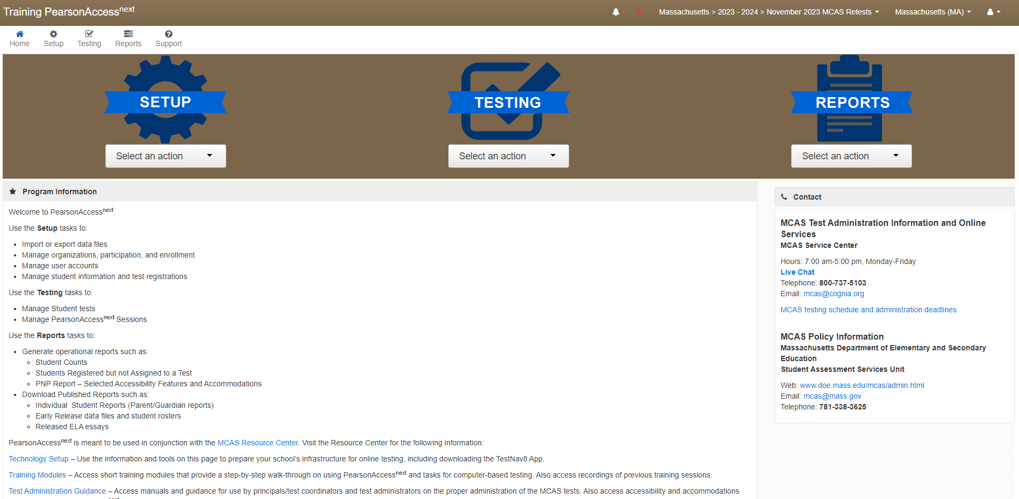
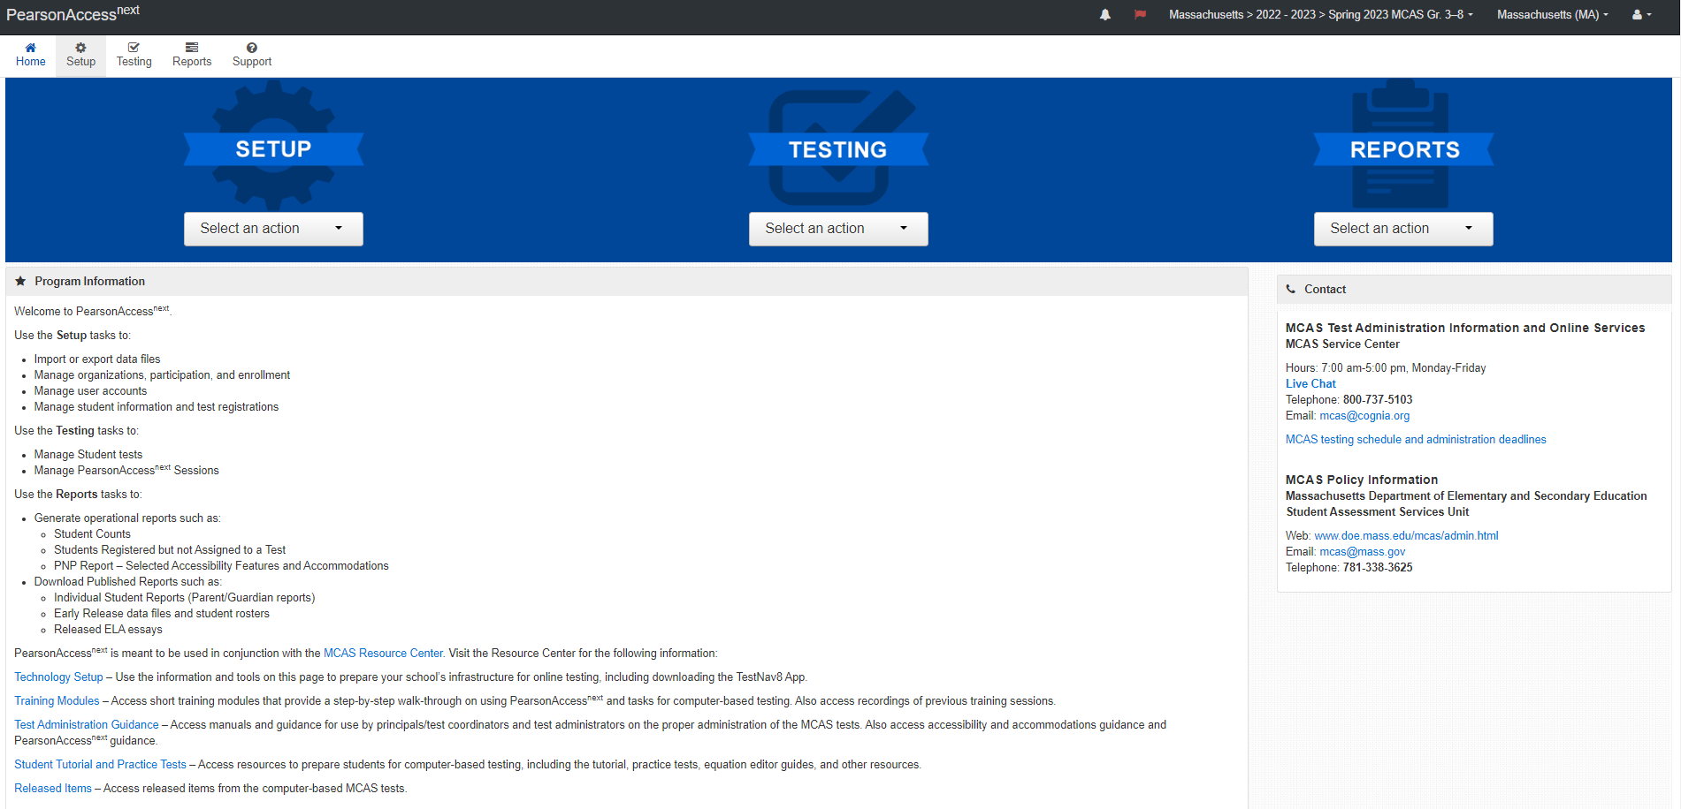
Demonstration
the brown training site vs. the blue live site

Slide 20
7. View online training modules and previous training sessions.
Visit the Training page on the MCAS Resource Center for modules as well as recordings/slides from previous live training sessions.
PAN Tasks to Complete Before, During, and After Testing
Three separate trainings
Intro to MCAS Computer-Based Testing
Overview of the SR/PNP Process
MCAS Accessibility and Accommodations

Slide 21
8. Meet with the technology coordinator, review technology specifications, and prepare the school’s infrastructure.
Meet with the technology coordinator.
Review specifications and resources:
TestNav System Requirements
Minimum and recommended specifications for hardware and devices
Recommended levels of bandwidth
Note special instructions for ChromeOS (Chromebooks).
Confirm whether all devices planned for testing will meet these specifications.
Network Requirements and Guidelines
Download the updated TestNav application on all testing devices.
Identify/address gaps in technology capacity such as
Potentially insufficient bandwidth
USDE guide on building technology infrastructure for learning
Follow the instructions for running a Network Check in the ProctorCache Recommendation for CBT

Slide 22
9. Plan for accessibility features (for all students) and accommodations for students with disabilities and English learners.
Review selected accessibility features for all students and accommodations for students with disabilities and ELs.
Include selected features and accommodations in the SR/PNP.
Before testing: required for student to receive correct test forms
After testing: to update features or accommodations used during testing
10. Complete the SR/PNP
The SR/PNP registers students for testing and places an initial order for PBT and for manuals.
SR/PNP window for the November retest administration is September 16-27.
See additional information in slides 36 to 55.

Slide 23
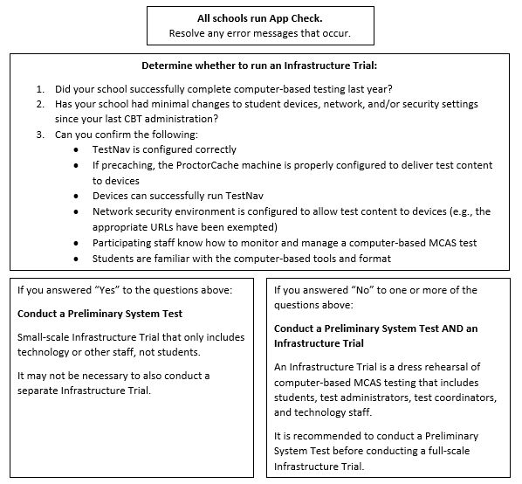
11. Run App Check and conduct an Infrastructure Trial or Preliminary System Test.
Resources:
Infrastructure Trial Guide
Infrastructure Trial for Principals and Test Coordinators module
Infrastructure Trial for Technology Coordinators module
Recordings of Infrastructure Trial training sessions
Schedule a call with Technology Support Specialists

Slide 24
12 and 13. Train test administrators in protocols and security requirements and review instructions in the Principal’s Administration Manual.
Schools will receive manuals on October 30.
PDF versions of manuals will soon be posted to the Test Administration Resources for the November 2024 Retests web page of the DESE website.
Excerpts from manuals will also be posted separately, including the test security requirements and the scripts for each test session.

Slide 25
14. Prepare devices and materials.
Plan to have enough devices for test administrators and for students.
Recommended tool: computer-based testing device planner
Ensure all devices will be charged prior to each test session.
Have materials available (and check to see if they are in working order):
Power cords, power strips, extra batteries, extra computers
If using tablets: external keyboards
If students are using text-to-speech: headphones
Schools may request to participate in BYOD (“bring your own device”) program by emailing MCAS@mass.gov. More information was provided in the August 27 Student Assessment Update.

Slide 26
15. Prepare students for online testing.
Ensure the curriculum incorporates digital learning; review the DLCS Curriculum Framework
Student Tutorial
Demonstration of the navigation, tools, and features for CBT
Students complete it independently (no audio).
Student Tutorial Table of Contents
Describes what is on each page of the tutorial and for which administrations
Practice tests
Simulation of the tools and features for CBT
Include accessibility features and special editions:
For example, students can gain familiarity with the text-to-speech and web extensions that are available.

Slide 27
Additional Resources
Additional resources for students
Sample student work and scoring guides
Released items
Answer keys and scoring rubrics for practice tests
Click on the subject, and then click on the grade.
Equation editor guides and symbol keys for Math and STE
Reference sheets for Math and STE (for all students)
Websites to complete test administration tasks
PearsonAccess Next
DESE Security Portal
MCAS page on the DESE website
MCAS Pre-Administration Guide for the November 2024 Retests
Statewide testing schedule
Test designs
Test administration resources
Student participation guidelines
Resources for parents/guardians
MCAS Resource Center
PAN Tasks Timeline

Slide 28
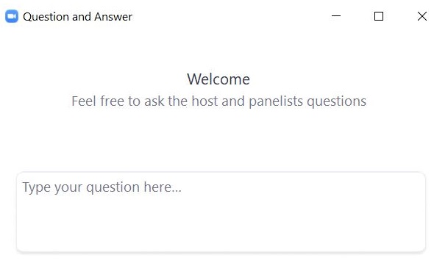
Questions & Answers
Use the “Q&A” feature to ask questions.

Slide 29
3. MCAS Accessibility Features and Accommodations

Slide 30
Accessibility Features & Accommodations
Accessibility and Accommodations Manual for the November 2024 Retest Administration
Simplified manual for November retest only
Includes all available accessibly features and accommodations
Changes to a student’s IEP are not required simply because the student is participating in retests, unless the student’s needs change.

Slide 31
Accessibility Features & Accommodations
Universal accessibility features: Tools and supports that are available to all students, either on the computer-based tests or their paper-based equivalents; some may need to be requested prior to testing via SR/PNP.
Designated accessibility features: Flexible test administration procedures that may be used with any student at the discretion of the principal or test coordinator
Accommodations: Specific supports available only to students with disabilities and ELs as detailed in a student’s IEP or 504 plan
Special access accommodations: May be provided to students who meet certain guidelines and criteria described in this document
EL accommodations: Accommodations available to ELs who do not have disabilities, as described in the PAM

Slide 32
Guidelines for English Learners
EL accommodations: School staff familiar with the student should meet and
Review available accessibility features and accommodations for ELs.
Consider EL students’ language needs, learning characteristics, and preferences.
A sample form to document EL accommodations is provided on the DESE website.

Slide 33
SR/PNP: Special Test Forms and Selected Accessibility Features and Accommodations
ELA
Math

Slide 34
Additional Resources for Accessibility Features and Accommodations
Practice tests and student tutorial
DESE MCAS Accessibility and Accommodations webpage
Graphic Organizers, Checklists, and Supplemental Reference Sheets for Use by Students with Disabilities
Training module and previously recorded training sessions on accessibility and accommodations
Nondisclosure Acknowledgment Forms (required for administering the following accommodations: A2, A3.1, A3.2, A3.3, A5, A6.1, A8, A10.1, A10.2, A11, A12, A13, A14, A15, SA1.2, SA2, SA3.1, SA3.2, SA6, EL3.2, EL4.1, EL4.2)

Slide 35
Questions & Answers
Use the “Q&A” feature to ask questions.

Slide 36
4. The SR/PNP Process

Slide 37
What is the SR/PNP?
Student Registration/Personal Needs Profile (SR/PNP) is a collection of student-level data, including
student demographic data
test registration information
information on selected accommodations that a student will use during testing
The SR/PNP process must be completed to determine the basis for the initial shipment of materials to schools, including
test administration manuals (CBT and PBT)
Student ID Labels for paper-based tests (PBT)
PBT test and answer booklets, including special test editions
The SR/PNP determines initial test orders and provides a record of students tested and the accommodations they used.
Submission deadline of September 27 for November 2024 Retest.

Slide 38
Participation Guidelines for the November Retest
Participation Guidelines
Note that students in the class of 2026 (current juniors) must earn higher scaled scores for the CD than earlier classes.
See the Massachusetts Graduation Requirements web page for additional information.
Schools and districts (incl. collaboratives and special education schools) can use Edwin PE613 to see students’ original graduating class.
The November Retest is the last opportunity for grade 12 students to test for scholarships
Last opportunity for grade 12 first-time testers to qualify for the Adams Scholarship
Last opportunity for grade 12 students to test for Koplik award purposes

Slide 39
Overview of Steps to Complete the SR/PNP Process
Download the .CSV file prepared by DESE from Dropbox Central in the DESE Security Portal (available on September 16).
Delete students from the file who are no longer enrolled in your school, and add rows for students who were not included in the file and will be testing.
Verify and update students’ accessibility features and accommodations.
Save as a .CSV file and import file into PAN.
Resolve any errors that occur.
Update student information as needed, through file export/import process or through the user interface.

Slide 40
For what reasons and when should we update the SR/PNP?
1. Initial SR/PNP Window
(Sept. 16–27)
2. Extended SR/PNP Window for CBT
(Sept. 30–Nov. 5)
3. Test Administration Window
4. Deadline for Updating SR/PNP (Nov. 18)
Add students
Remove students/test assignments
Edit accommodations
Edit demographic info
Same as 1, but additional steps are required for some accommodations
Same as 1, but may need to order paper-based tests for new PBT accommodations
Remove students/ test assignments
Edit accommodations that were not used
Edit demographic info

Slide 41
Guide to the SR/PNP Process
Includes:
Instructions for completing the initial process
Instructions for updating student information after the initial file upload
Field Definitions section:
Field Definitions describe each of the columns in the SR/PNP file.
Includes details on test codes (column J)
Field Notes and Validations describe eligibility to receive the accommodation and describe how to complete that field.
Expected Values indicate options for column input.
Appendix A: PAN Guidance for Form-Dependent Accommodations
Available on the MCAS Resource Center under “PearsonAccess Next Guidance.”

Slide 42
Form-Dependent Accommodations
The following accommodations must be assigned correctly before testing. If not assigned correctly, a student’s test will need to be stopped and a new test will need to be set up, and the student may need to retake a portion of the test.
Form-dependent accommodations for CBT:
Text-to-speech
Screen reader
Spanish/English
Compatible assistive technology
Human read-aloud
Human signer
Form-dependent accommodations for PBT:
Large-print
Braille
See Appendix A: PAN Guidance for Form-Dependent Accommodations in the Guide to the SR/PNP Process

Slide 43
Steps for Preparing the Initial File for Import
Download the .CSV file prepared by DESE from Dropbox Central in the DESE Security Portal (available on September 16).
Delete students from the file who are no longer enrolled in your school, and add rows for students who were not included in the file and will be testing.
Verify and update students’ accessibility features and accommodations.
Save as a .CSV file, and import file into PAN.
Resolve any errors that occur.
Update student information as needed, through file export/import process or through the user interface.

Slide 44
Secure Websites for this Process
DESE Security Portal: where to find the .CSV files that can be used as the basis for the SR/PNP
https://gateway.edu.state.ma.us/
If you cannot access the Security Portal, contact your Directory Administrator (www.doe.mass.edu/InfoServices/data/diradmin/list.aspx).
PearsonAccess Next (PAN): where to import the SR/PNP file
http://mcas.pearsonaccessnext.com
Also linked at http://mcas.pearsonsupport.com/pearsonaccessnext/
If you could access PAN before but no longer have access, try resetting your password in case the account expired.
If you do not have a PAN account, contact your school or district test coordinator.
Call MCAS Service Center (800-737-5103) if you cannot access your PAN account or for assistance with the SR/PNP import.

Slide 45
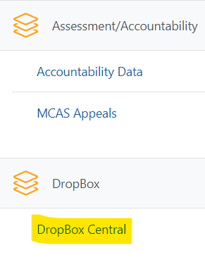
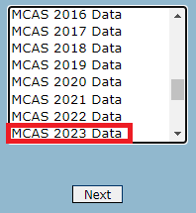
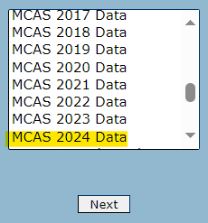
Accessing DropBox Central in the Security Portal
Log in to the Security Portal at https://gateway.edu.state.ma.us/
Enter your username and password.
You will then see an Application List.
Select DropBox Central.
Select MCAS 2024 Data.
Click Next.

Slide 46
The .CSV File for the November 2024 Retest Administration
DESE will post .CSV files to DropBoxes on September 16.
Locate the .CSV file (e.g., “Nov2024_Retest…_SRPNP) and save it to your computer.
The .CSV files for the SR/PNP will be current as of approximately two weeks before the opening of the window.
Accessibility features and accommodations are not pre-populated.

Slide 47
Demonstrations: Tasks before Importing the File
Opening the .CSV file downloaded from DropBox Central
Adding/removing rows for a student who transfers in/out
Adding a student’s accommodations
Saving the .CSV file

Slide 48
SR/PNP Initial Import – Step A: Prepare the File
Log in to the Security Portal (https://gateway.edu.state.ma.us/) to find the .CSV file posted in DropBox Central in the MCAS 2024 folder.
District and school files are available the same day that the SR/PNP window opens.
Delete rows of students who will not participate; add rows for new students who will participate.
Add any accommodations, as needed.
Save the updated file as a .CSV file.

Slide 49
Overview of Steps to Complete the SR/PNP Process
Download the .CSV file prepared by DESE from Dropbox Central in the DESE Security Portal (available on September 16).
Delete students from the file who are no longer enrolled in your school, and add rows for students who were not included in the file and will be testing.
Verify and update students’ accessibility features and accommodations.
Save as a .CSV file, and import file into PAN.
Resolve any errors that occur.
Update student information as needed, through file export/import process or through the user interface.

Slide 50
Demonstrations: Importing the File
Accessing PearsonAccess Next
Importing the .CSV file

Slide 51
SR/PNP Initial Import – Step B: Import the File
Log in to PearsonAccess Next (PAN) (https://mcas.pearsonaccessnext.com/).
Select the appropriate test administration in the top right.
Note: PAN will default to the last administration you were working in.
On the Setup menu, select “Import/Export Data.”
In the Select Tasks drop-down, select “Import/Export Data.” Click “Start.”

Slide 52
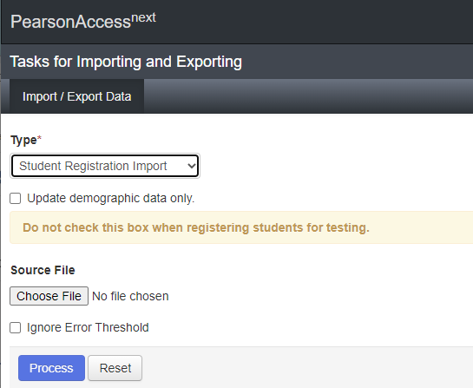
SR/PNP Initial Import – Step B: Import the File (cont’d)
In the Type drop-down, select “Student Registration Import.”
Ignore the option “Update demographic data only.”
Choose the .CSV file you had previously saved, and select “Process.”
Click refresh and when the file has completed processing, a green box with the message “Complete” will appear on the screen.
Confirm that all records have been successfully imported.

Slide 53
SR/PNP Import Errors
You may receive errors when importing the file into PAN.
See Part IV of the Guide to the SR/PNP Process for a list of common errors that may occur and how to resolve them.

Slide 54
Steps after the Initial Import
Update SIMS data
If you update any student demographic data in PAN (SASID, spelling of student’s name, grade, DOB), you must also update student information in SIMS.
Contact the district’s SIMS contact.
To find the contact for your district, go to https://profiles.doe.mass.edu/search/search.aspx?leftNavId=11239 Select “SIMS Contact” from the Function menu, and click “Get Results.”
Add new students as needed (instructions in the Guide to the SR/PNP Process)
Update existing student records as needed (instructions in the Guide to the SR/PNP Process)

Slide 55
Additional Resources for the SR/PNP
Guide to the SR/PNP Process
SR/PNP module and recordings of previous trainings
Guidance on Enrollment Transfer Requests
Demonstration available at timestamp 15:19 in the recording of the Tasks in PAN Before Testing webinar from February 27, 2024

Slide 56
Questions & Answers
Use the “Q&A” feature to ask questions.

Slide 57
Additional Resources
Resource | Location
MCAS Resource Center | mcas.pearsonsupport.com
Modules and recordings of previous trainings | mcas.pearsonsupport.com/training
PAN user information | mcas.pearsonsupport.com/pearsonaccessnext
Student Assessment Updates (Biweekly email with important updates about the MCAS program) | www.doe.mass.edu/mcas/updates.html If you do not already receive this email, subscribe using this link: http://eepurl.com/ghSOhH
Released Items | mcas.pearsonsupport.com/released-items
Participation Guidelines | www.doe.mass.edu/mcas/highschool.html

Slide 58
Next Steps
Today: Complete the evaluation form.
Responses are associated with the name and email address used to log in.
Email your input to mcas@mass.gov if you have problems accessing or completing the form.
Within one week:
Receive an email with the Q&A from this session
Recording will be available

Slide 59
Email and Phone Support
MCAS Service Center
DESE Student Assessment Services
Questions on logistics and technology (e.g., PearsonAccess Next, SR/PNP, TestNav)
Web: mcas.pearsonsupport.com
Email: mcas@cognia.org
Phone: 800-737-5103
Schedule Technology Support Call.
Policy questions (e.g., student participation, accommodations)
Web: www.doe.mass.edu/mcas
Email: mcas@mass.gov
Phone: 781-338-3625

Slide 60
5. Live “Sandbox Time”

Slide 61
Poll Question—
Which demonstrations would you like to see again?
Brown training site vs. blue live site
Adding/removing rows for a student who transfers in/out
Adding a student’s accommodations in the initial .CSV file
Accessing PearsonAccess Next
Importing the .CSV file

Slide 62
Poll Question—
Which additional demonstrations would you like to see?
Run the PNP operational report to review accommodations prior to testing
Adding a student after the initial file import
Updating an existing student record after the initial file import
Updating a large number of student records via Student Registration Export/Import
Enrollment transfer work request

Slide 63
THANK YOU
The Office of Student Assessment Services
781-338-3625
mcas@mass.gov
www.doe.mass.edu/mcas
135 Santilli Highway, Everett, MA 02149

